Slide 1
Week 2

Slide 2
Recap: Handling of Crime Scenes
Handling of crime scenes must be done meticulously to ensure the integrity of evidence remains intact and adhere to the Rules of Evidence. This framework entails the activities to be taken in handling of crime scenes.
Approval of Authorisation
Preparation
Identification
Preservation
Covered in Week 1

Slide 3
Handling of Crime Scenes: Data Preservation

Slide 4
Data Preservation
Why do we need to preserve the integrity of data in crime scenes?
The objective is to ensure that
The state of the devices when found in the crime scenes remain intact
when they are brought back to labs for analysis.
No changes made to the data in the devices.
No communication was made to the devices when they are transported from the crime scene to the lab.
At the location of crime scenes, mobile devices found may be in either powered on or powered off state. The steps taken in data preservation differ in both scenarios.

Slide 5
Data Preservation (At Crime Scene)
 | Device is turned on
Mobile Devices (Important) | Follow these steps in chronological order Take photo of the location of the mobile device Ask the owner for the lock screen password (alphanumeric, patterns) Unlock the mobile device
 | Enable Airplane mode Disable WiFi settings Disable Bluetooth settings Remove SIM cards
 | Take camera shots of the running applications Disable face recognition feature
To ensure that there is no incoming communication made to the mobile device immediately after the investigator unlocked it

Slide 6
Data Preservation (At Crime Scene)
 | Device is turned on
Mobile Devices (Important) | Follow these steps in chronological order 10) Switch off the mobile device
 | 11) Take camera shots of all sides of a mobile
 | device. Minimally, there should be 6 camera shots to reflect all sides of the device. Additionally, close up photos of visible damages can be taken as well.
To photographically document visible damages such as cracked screen, scratches or broken parts.

Slide 7
Data Preservation (At Crime Scene)
 | Device is turned off
Mobile Devices (Important) | Follow these steps in chronological order Take photo of the location of the mobile device Remove the battery (applicable to older phones only) Remove memory cards Remove SIM cards Ask the owner for the lock screen password (alphanumeric, patterns) Take camera shots of all sides of the mobile device Minimally, there should be 6 camera shots to reflect all sides of the device. Additionally, close up photos of the visible damages can be taken as well.
To take note of any visible damages such as cracked screen, scratches or broken parts.

Slide 8
Data Preservation (At Lab)
Only applicable to mobile devices that are found in powered off state at crime scene locations
Mobile Devices (Important)
Follow these steps in chronological order
Switch on the mobile device in a faraday box
Unlock the mobile device with the lock screen password given (alphanumeric/pattern)
Faraday box jams all signals that can be received by the mobile device.
Enable Airplane mode
Disable WiFi settings
Disbale Bluetooth settings
By switching on the mobile device in the faraday box, we eliminate any chances of immediate incoming messages/calls to the device when we power it on.
By this way, we can preserve the state of the
mobile device.

Slide 9

Faraday Box

Slide 10
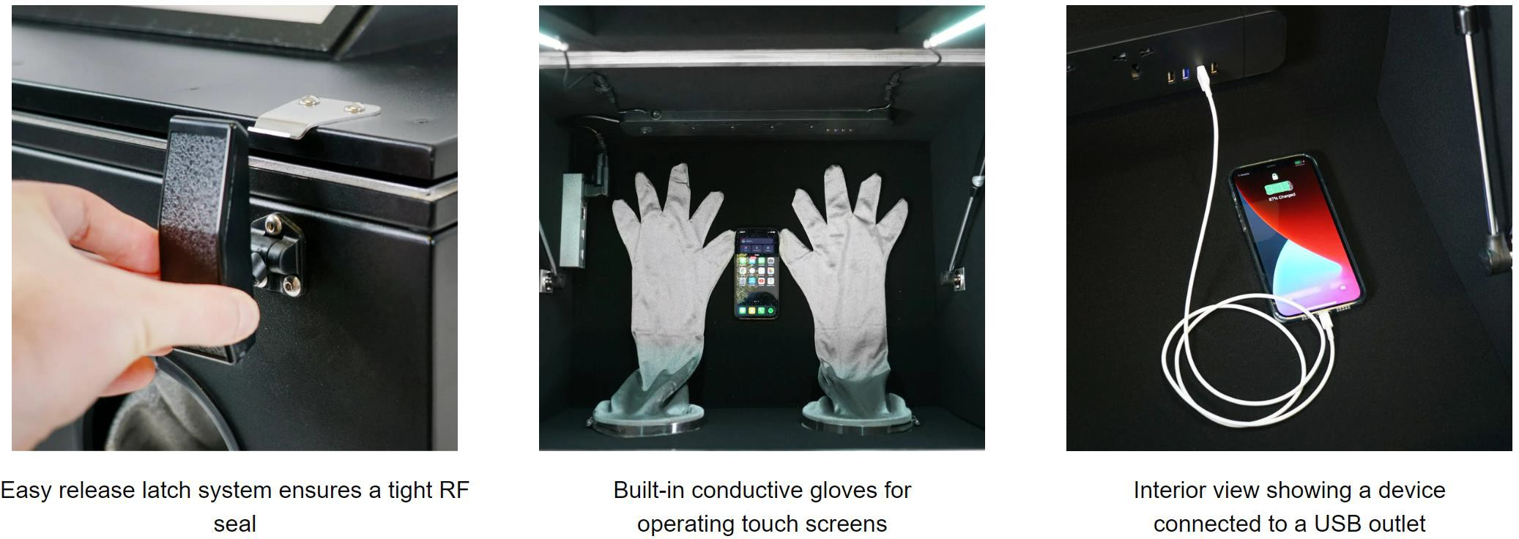
Faraday Box

Slide 11
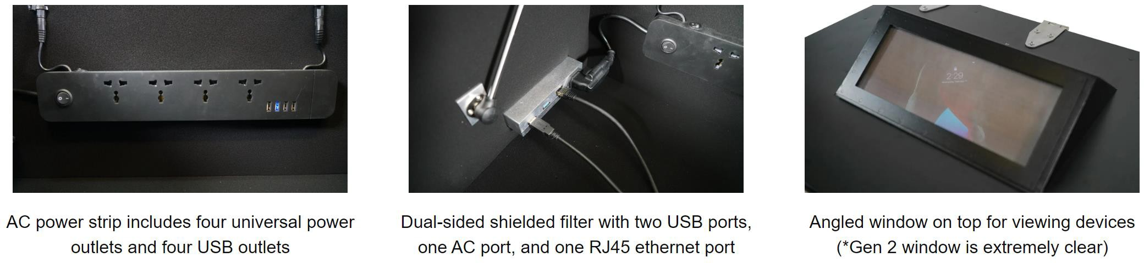
Faraday Box

Slide 12
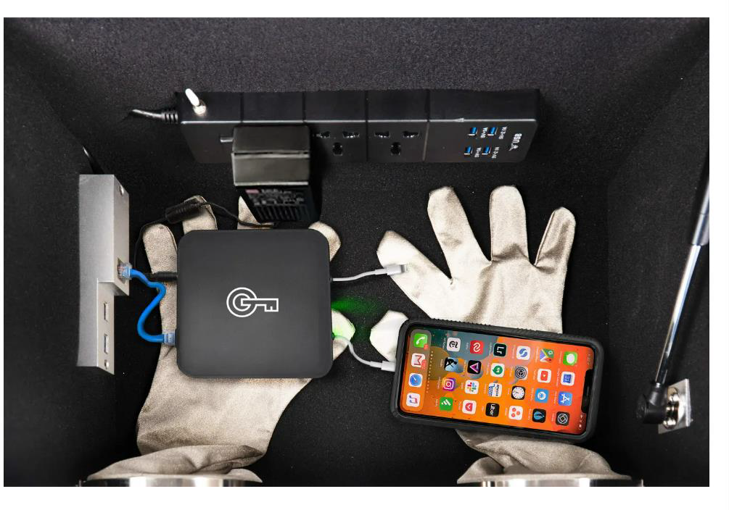
Faraday Box
Gloves to operate the mobile device in a Faraday Box
Mobile Extraction Software

Slide 13
Definition of Evidence Tampering
Evidence Tampering is any intentional or unintentional alteration, deletion, or addition of digital data that affects the original state or the meaning of the evidence.
This act can be performed by both criminal offenders and digital forensic examiners with intentional and unintentional intents, respectively.

Slide 14
Evidence Tampering (by Criminal Offenders)
Methods | Examples
Data Wiping | Perform factory reset on mobile devices.
Physical Destruction of the device containing the digital evidence | Hammer down the lock screen of a mobile device Dip the mobile device in water to disable USB connections.
Data Wiping and Physical Destruction prevents extraction of mobile devices via forensic tools to take place.

Slide 15
Evidence Tampering (by DF examiners)
Methods | Examples
Data Wiping | Perform factory reset on mobile devices.
Add new data to original sources of digital evidence | Connect the mobile device to a standalone workstation. Digital examiner then access the file directory of the mobile device via workstation’s file explorer. He opens a Word document and make changes to the content. Connect the mobile device to a standalone workstation. Digital examiner accidentally perform a reformat on the mobile device.
Data Wiping prevents the extraction
of the mobile device to take place.
Accessing a mobile device freely via the workstation’s file explorer allows changes to be metadata, adding new files and deletion of existing files on the mobile device itself.

Slide 16
Next Learning Outcome in Week 3
2nd Part of Collection Phase: Acquisition methods for Mobile Devices
Examination Phase of the DF Framework

